Slide 1





HEALTHCARE
HEART DISEASE PREDICTION PROJECT
PROJECT BY:
FIDES ANGELENE MANALO

Slide 2

OBJECTIVE
This project aims to build a machine learning model to predict the presence of heart disease based on various demographic, clinical, and lifestyle-related features.
It integrates data science methodologies to enable early detection and improve health outcomes through preventive care.

Slide 3

The dataset contains anonymized patient data, including
demographic (age, gender),
clinical (blood pressure, glucose, cholesterol),
and lifestyle (smoking, alcohol use) features.
The target variable is 'disease', indicating the presence (1) or absence (0) of heart disease.
DATA INFORMATION

Slide 4
DATA PREPARATION & CLEANING
Check if the data had any missing values or duplicates - none were found.
Non-informative columns such as 'id', 'country', and 'date' were dropped to improve model performance.

Slide 5



EXPLORATORY DATA ANALYSIS
KEY OBSERVATIONS
Roughly half of the patients in the dataset do not have Heart disease
High correlation observed between features like age, cholesterol, and blood pressure.
These factors were further analyzed in feature importance plots.

Slide 6




MODELING APPROACH
Five models were evaluated:
Logistic Regression
Decision Tree
Random Forest
Support Vector Machine
XGBoost
The dataset was split into training and testing sets (80/20), and models were evaluated using accuracy and ROC-AUC.

Slide 7

PERFORMANCE SUMMARY
MODEL
ACCURACY
ROC-AUC
XGBOOST
73.19%
0.795
SVM
72.54%
0.782
Logistic Regression
71.39%
0.778
Random Forest
71.66%
0.772
Decision Tree
63.15%
0.631
XGBoost achieved the highest ROC-AUC score and is recommended for deployment.

Slide 8
FEATURE IMPORTANCE
Top predictive features across models:
Systolic Blood Pressure (ap_hi)
Age
Weight
Height
Cholesterol
These features consistently ranked high in
Random Forest,
XGBoost,
and Decision Tree models.

Slide 9
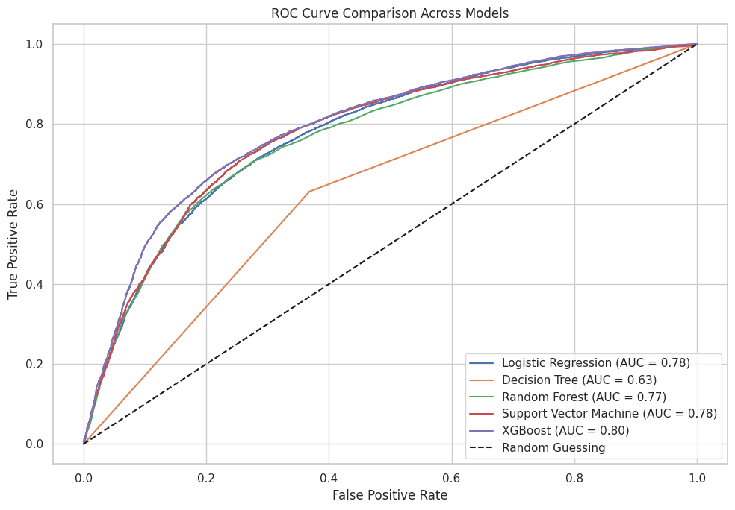

ROC CURVE COMPARISON
ROC curves were plotted for each model. XGBoost displayed the highest area under the curve, indicating superior classification ability in distinguishing between heart disease and non-disease cases.

Slide 10
CONCLUSION
XGBoost emerged as the most accurate and reliable model for predicting heart disease. Logistic Regression and Random Forest also performed well and could serve as interpretable alternatives. Decision Trees performed weakest.
Critical medical features like blood pressure, age, and cholesterol were confirmed to significantly impact prediction.

Slide 11
RECOMMENDATIONS & FUTURE WORK
Based on the analysis, I recommend XGBoost for deployment in predictive healthcare systems where performance is critical. However, Logistic Regression and Random Forest are also strong candidates, particularly when interpretability and ease of use are essential. Decision Trees, while useful for exploratory analysis, are not recommended as standalone models due to their lower predictive performance.
While the current results are promising, several directions can be pursued to improve and extend this study:
Feature Expansion: Additional variables such as exercise frequency, diet, medication use, and family history of heart disease could enhance model performance.
Hyperparameter Tuning: Further optimization of model parameters, especially for complex models like XGBoost and SVM, could lead to performance gains.
Cross-Validation: Implementing k-fold cross-validation would ensure more robust model evaluation and generalizability.
Imbalanced Data Handling: Techniques such as SMOTE or class weighting could improve model sensitivity to minority cases if class imbalance becomes an issue in future datasets.

Slide 12
THANK YOU

